Slide 1
Mservice - Export Mechanism

Slide 2
TECHNICAL COVERAGE
Method 1 : Screen Level Export :
Step 1 : The HTML file of the screen to have the html element for export option which will be placed under screen editor section.
Example : <li id = "manage_call_register_se_grid_1_export_btn" class = 'k-button' data-widget-type = "w_button" data-button-group = "export" data-button-role = "grid" style="border:none;border-radius:0px;" title="Export"><span class= 'k-icon k-i- excel'></span></li>
Step 2 : Based on the export access of the screen this button is shown or hidden to the respective user groups.
Step 3 : The JS file of the screen has the function to get the input parameters for the export functionality. The function path is given below. screenObject.customRequirementHandler.getExportConfig(exportButtonId); The above JS Function returns 5 parameters which are sent as input to export functionality.
type : export file type , template : fmt file name, service : retrieve procedure, request : input params for retrieve procedure, length : length of the data

Slide 3
TECHNICAL COVERAGE
Sample Structure of the input function :
getExportConfig : function (gridId) {
if(gridId == "manage_call_register_se_grid_1_export_btn"){
return {
type : "csv",
template : "manage_call_register_se",
service : "sp_retrieve_manage_call_register",
request : "<signature><i_inputparam_xml>" + manage_call_register_se.
customRequirementHandler.getFilterValues().replace("</inputparam>","<skip> </skip><take></take></input param>") + "</i_inputparam_xml> <o_retrieve_status></o_retrieve_status></signature>",
length : manage_call_register_se.variable.custom.grid_1.dataSource.data().length
}
}
}

Slide 4
TECHNICAL COVERAGE
Step 4 : Preparing the fmt file. The path of the fmt file will be Website\fmt\export. The name of the fmt name is formulated as templateProperty given in JS function + ‘_fmt,json’ format.
Sample fmt file name : manage_call_register_se_fmt.json
Sample Structure inside the fmt file :
{
"fileName": "CALL_REGISTER", /* Export File Name */
"configuration": [{ /* Fileds to Export */
"fieldName": "Call #",
"fieldId": "call_no",
"template": "",
"format": ""
}]
}

Slide 5
TECHNICAL COVERAGE
Step 5 : Upon clicking the export button the control goes to webScreenController.lib.js file.
$.ajax({
method: "POST", url: getWebserverpath() + "api/generate_export_file",
data: {
session_id: login_profile.guid_val, user_id: login_profile.user_id,
client_id: login_profile.client_id, locale_id: login_profile.locale_id,
country_code: login_profile.country_code, document_type: exportDataConfig.type,
document_template: exportDataConfig.template,
data_retrieve_service_name: exportDataConfig.service,
data_retrieve_request_xml: exportDataConfig.request
},
async: false
}).then(function (response) {
if (response != "") {
window.location = getWebserverpath() + "api/DownloadExportFile?filePath=" + response + "&client_id=" + login_profile.client_id + "&country_code=" + login_profile.country_code;
} else {
alert("Please contact your support desk.");
}
});

Slide 6
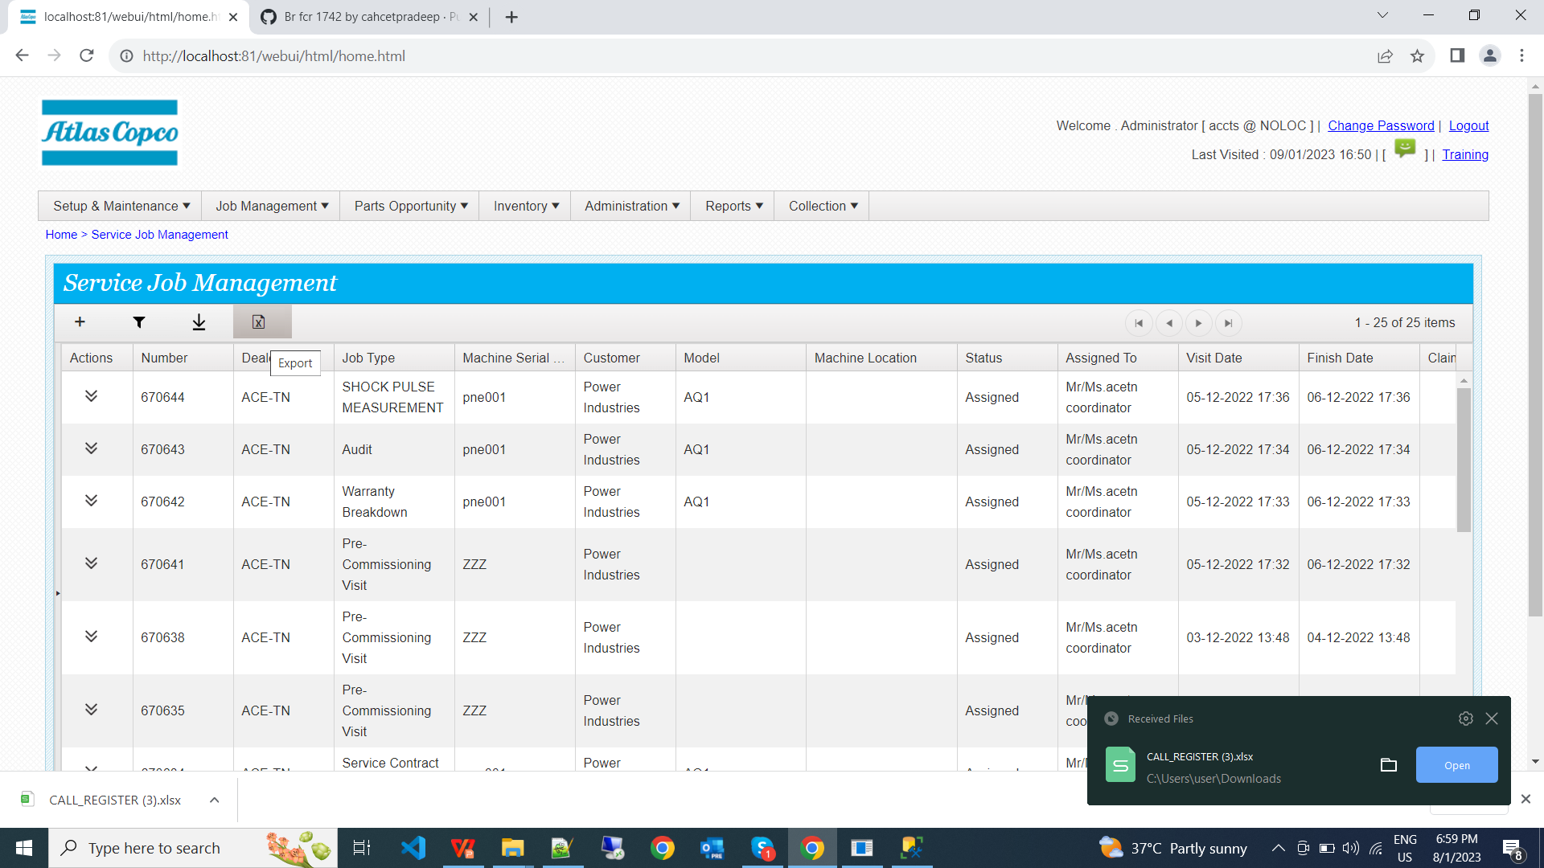
TECHNICAL COVERAGE

Slide 7
Method 1: Possible Failures Points
If fmt structure is wrong or missing or mismatch of fields error will occur.
If procedure is failed or take long to execute then error will occur.
If property values in JS function is not available or mismatch then error will occur.
The Errors are logged in the below given file path : website\Log\Export\exception\dd-MM-yyyy-clientId-countryCode.txt

Slide 8
TECHNICAL COVERAGE
Method 2 : Dashboard detail data export
Service Triggered : common/components/msvIntegrate/GenerateExportFile.aspx
Input for the Service :
document_type : CSV - hardcoded value
document_name : If available in ui config pick it up else named as Detailed Data
document_template : fmt file name
data_retrieve_service_name : "sp_report_information_for_custom_report_builder"
data_retrieve_request_xml: "<signature><i_inputparam_xml>" + exportObj.inputParam.replace("<inputparam>", "<inputparam> <export_ind> true </export_ind>") + "</i_inputparam_xml><i_report_code> " + ome_container.variable.custom.reportTypeList[reportIndex].reportCode + "</i_report_code><o_retrieve_status></o_retrieve_status></signature>"

Slide 9
TECHNICAL COVERAGE
fmt file path :
website\fmt\msvDocGen\csv\reportId_clientId_countryCode_localeId_fmt.xslt
Sample fmt file : reportId and fieldId parameters has to be given as per user requirement.
<?xml version="1.0" encoding="UTF-8"?>
<xsl:stylesheet version="1.0" xmlns:xsl="http://www.w3.org/1999/XSL/Transform">
<xsl:template match="reportId">
"Field 1 Label","Field 2 Label"
<xsl:for-each select="app_usage_version_classification">
<br/>
"=""<xsl:value-of select="field_1_id"/>""",
"=""<xsl:value-of select="field_2_id"/>"""
</xsl:for-each>
</xsl:template>
</xsl:stylesheet>

Slide 10
THANK YOU

